Slide 1


ROLE OF NUTACEUTICALS IN MANAGING MAJOR DEPRESSIVE DISORDERS
By-
Dibyendu Maji, Subham Mondal, Sudipta Hait
Under the guidence of-
Ms. Sushruta Chakraborty
Asst. Professor (Department of Pharmacology)
Dr. B. C. Roy College of Pharmacy and Allied Health Sciences, Durgapur

Slide 2
CONTENT
INTRODUCTION
CAUSE
PATHOPHYSIOLOGY
TREATMENT
MEDICATION USED IN MDD
DRAWBACK OF TREATMENT
NUTRACEUTICALS DEFINATION
NUTRACEUTICALS USED IN MAJOR DEPRESSIVE DISORDER.
CONCLUSION.

Slide 3
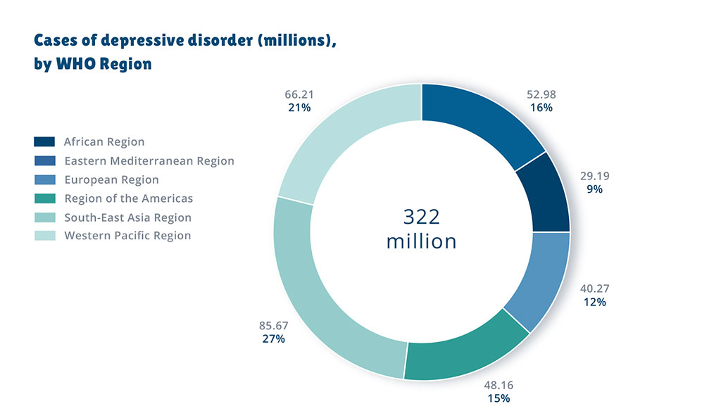
INTRODUCTION
Major depressive disorder, also known as clinical depression is a common mental disorder associated with feeling of sadness ,loss of interest, self neglect, anorexia , sleep disturbance & suicidal feeling in severe cases etc.

Slide 4
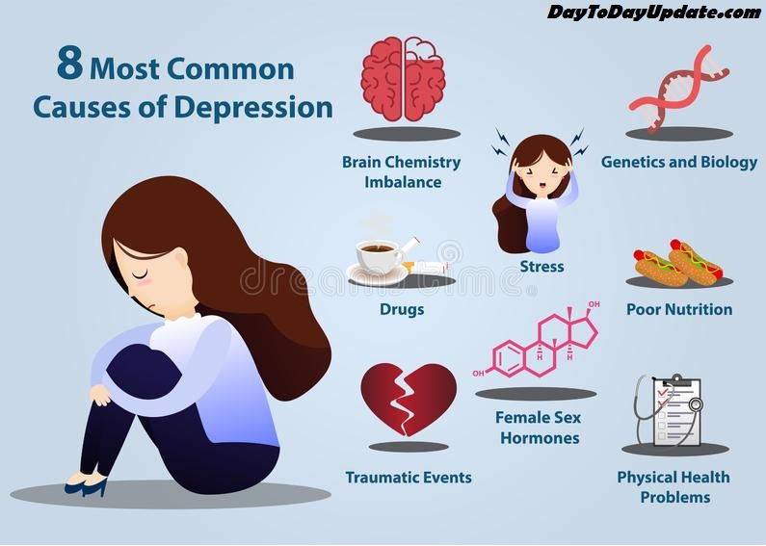
CAUSE

Slide 5
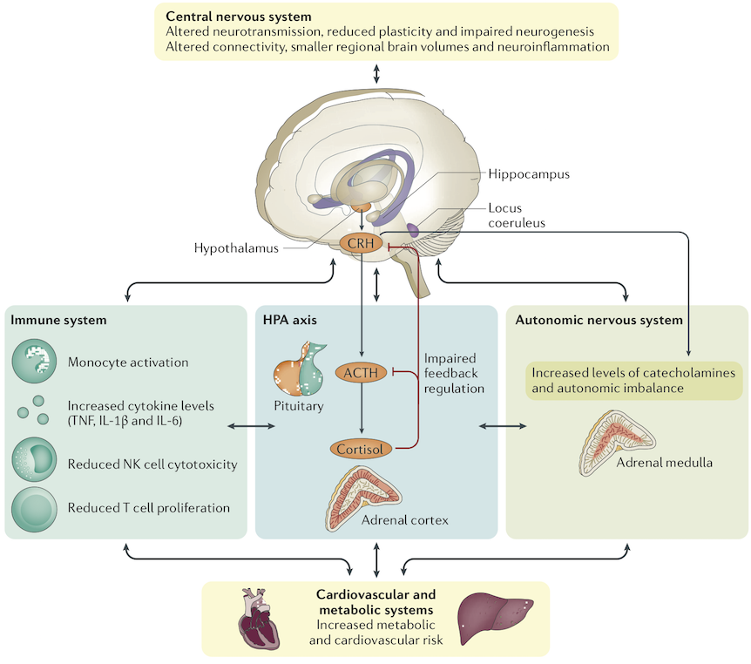
PATHOPHYSIOLOGY
GENES AND PSYCHOSOCIAL
STRESS
STRESS HORMONES AND
CYTOKINES
THE MEDIATING ROLE OF
MONOAMINES
ALTERED GLUTAMATERGIC
& GABAERGIC
NEUROTRANSMISSION
CIRCADIAN dysfunction

Slide 6
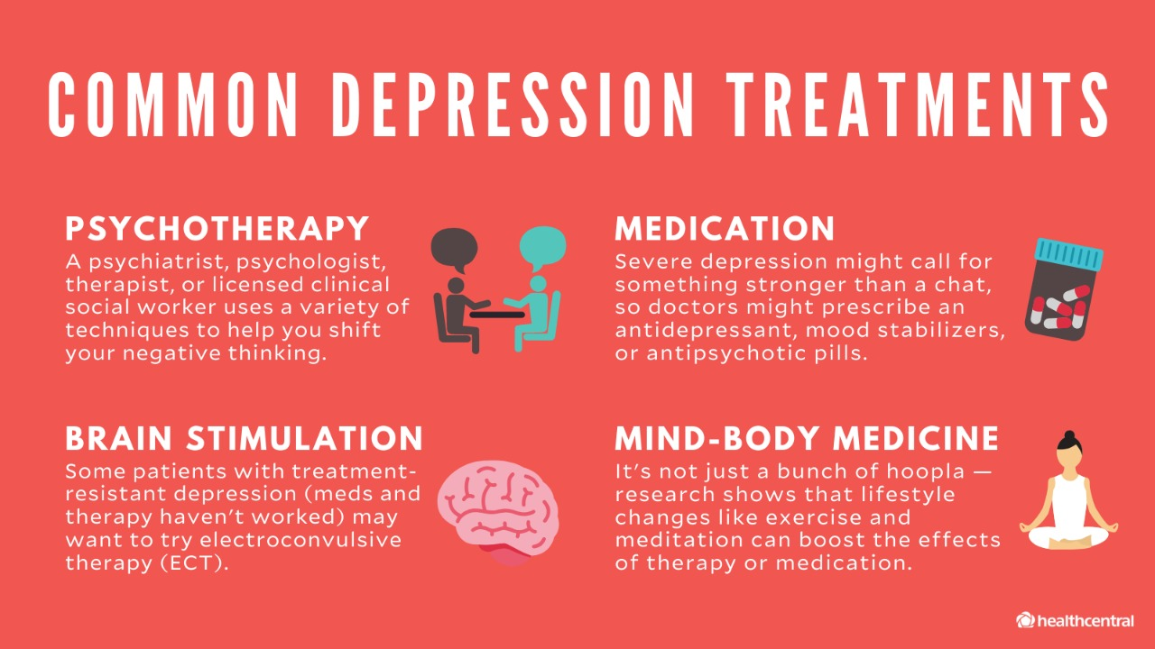
TREATMENT
Depending on the severity and pattern of depressive episodes over time, health-care providers may offer psychological treatments such as behavioral activation, cognitive behavioral therapy and interpersonal psychotherapy, and/or antidepressant medication such as selective serotonin reuptake inhibitors (SSRIs) and tricyclic antidepressants (TCAs).
More than 75% of people in low- and middle-income countries receive no treatment for depression.

Slide 7
MEDICATION USED IN MDD
CLASS
DRUGS
SSRIs
SNRIs
MAOIs
TCAs
MISCELLANEOUS
Escitalopram, Sertraline
Duloxetine , Venlafexine
Selegiline , Phenelzine
Amitriptyline,Doxepin,
Nortriptyline
Bupropion , Mirtazapine

Slide 8
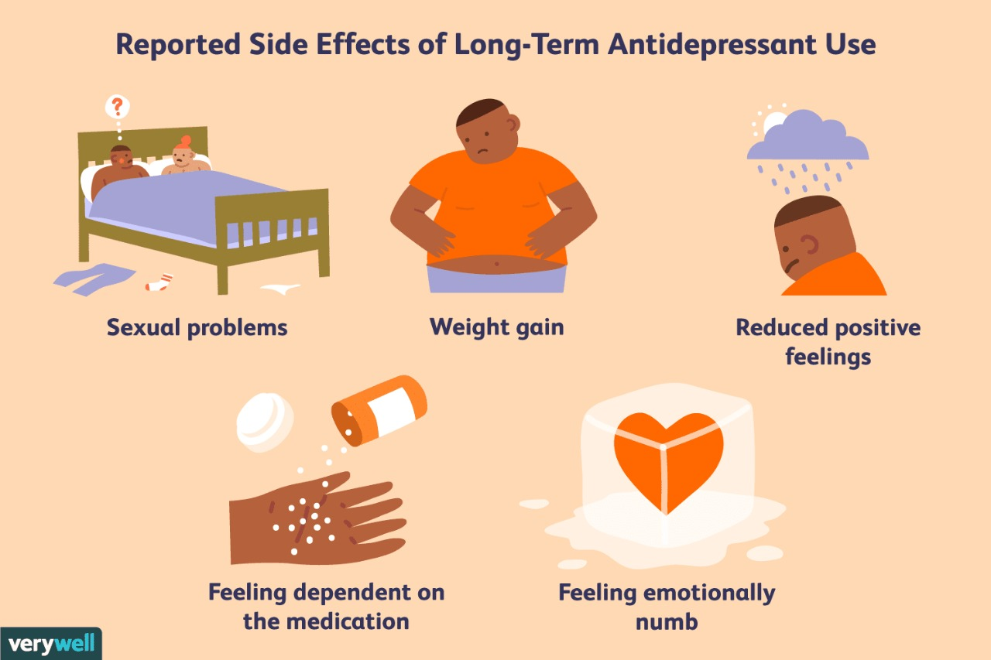
DRAWBACKS OF TREATMENT

Slide 9
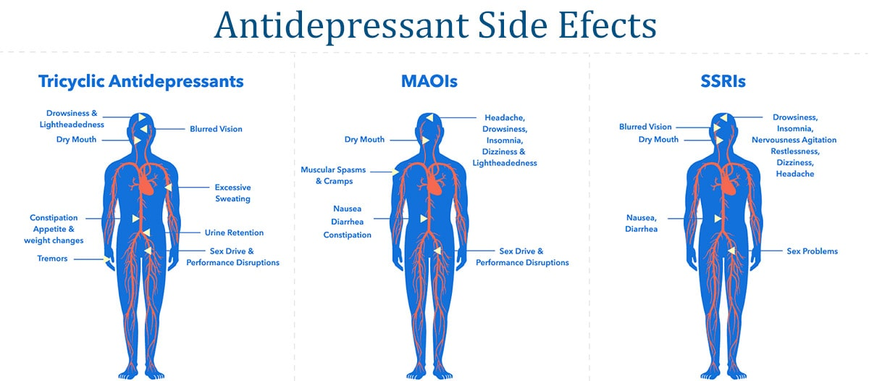
Contin….
Withdrawal reactions are similar to having the flu, or getting dizzy, or having electric shock sensations in the head. Gradually cutting down the dose is the main treatment
About 40% of patients taking antidepressants will gain weight
About 60% of people taking the modern antidepressants operating on the serotonin pathway will develop sexual side-effects.
Drowsiness.

Slide 10
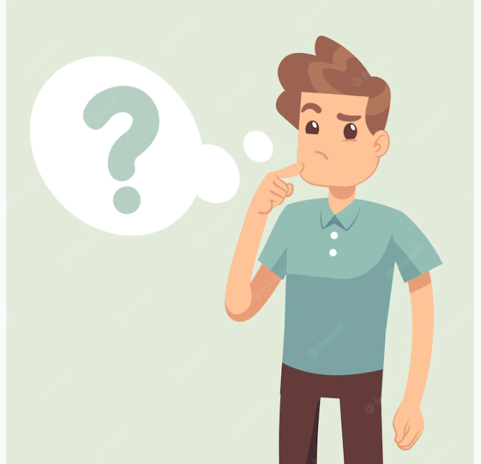
WHAT ELSE…..
Thus, an integrative approach of MDD is critical to address this global and growing concern, including medical care, proper nutrition, physical activity and psychotherapy but they have many drawbacks and adverse effect on depressive patient. In this sense, Now a days nutraceuticals as a potential therapeutic agent in patients with MDD……

Slide 11
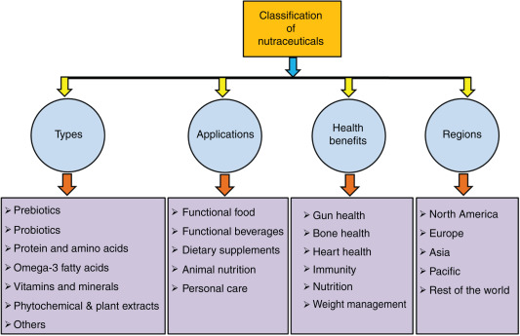
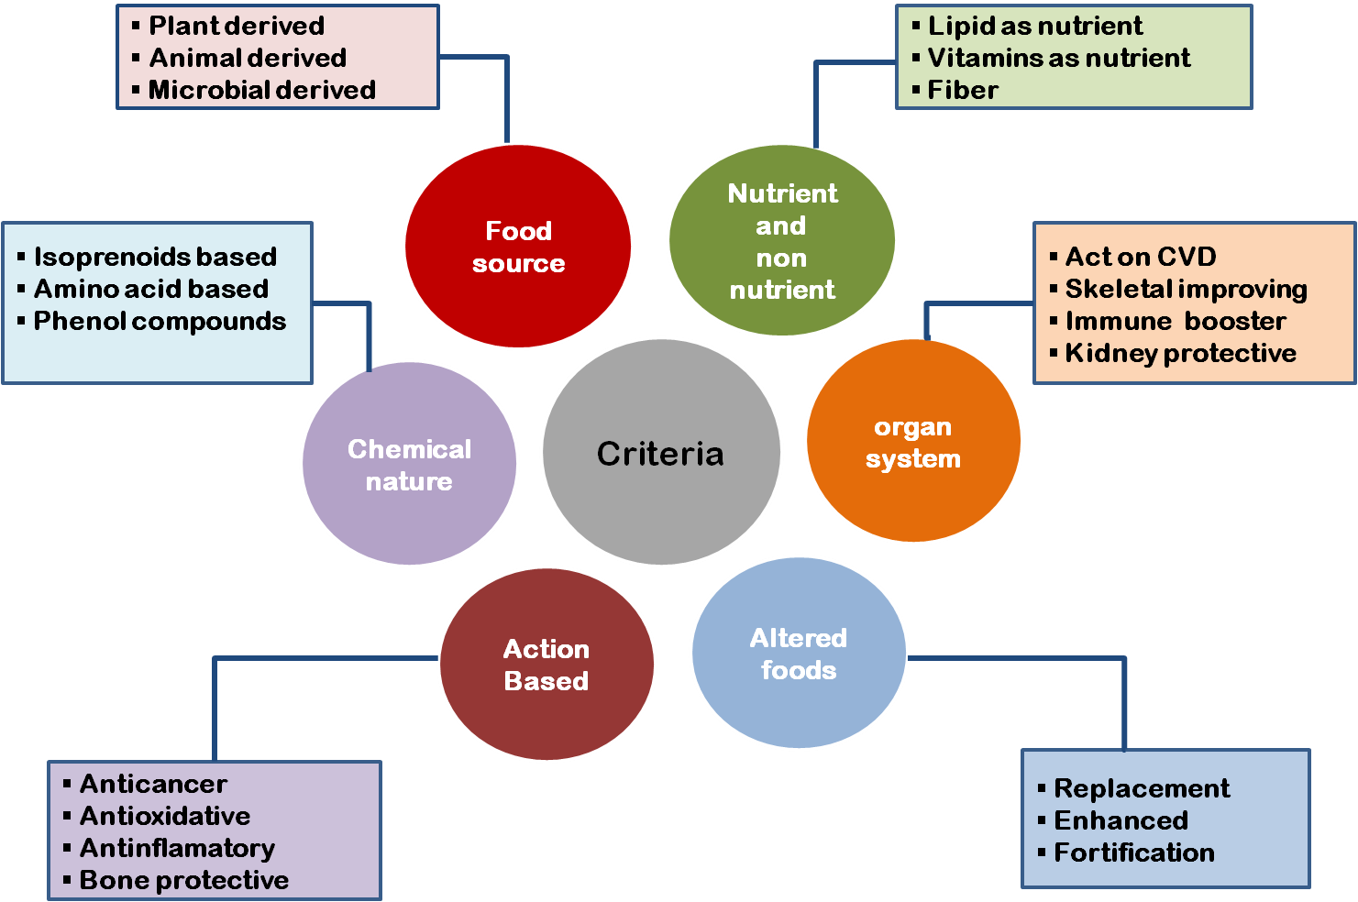
Nutraceuticals - A nutraceutical product may be defined as a substance, which has physiological benefit or provides protection against chronic disease. Nutraceuticals may be used to improve health, delay the aging process, prevent chronic diseases, increase life expectancy, or support the structure or function of the body.

Slide 12
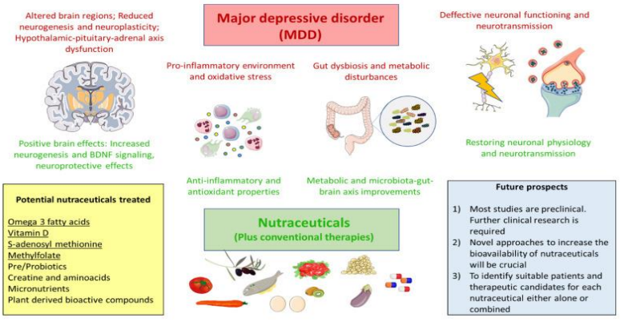
NUTRACEUTICALS USED IN DEPRESSION

Slide 13
CONCLUSION
we summarize some of the most relevant and updated researches regarding the use of nutraceuticals in preclinical and clinical studies of MDD. Our work means to give an extensive data either for logical and overall population, supporting to recognize potential and valuable uses of nutraceuticals in MDD while empowering for future attempt in this promising field. Omega 3 unsaturated fats, vitamin D, SAMe and methylfolate are the nutraceuticals most effective. Micronutrients, prebiotics, probiotics,amino acids and plant-determined bioactive mixtures are showing a few promising outcomes. Future studies on this field will bring more benefits in the clinical and translational use of nutraceuticals in many conditions, including Major Depressive Disorder.

Slide 14
REFERENCE
American Psychiatric Association . Diagnostic and Statistical Manual of Mental Disorders (DSM-5®) American Psychiatric Association; Arlington, TX, USA: 2013.
Hirschfeld R.M. History and evolution of the monoamine hypothesis of depression. J. Clin. Psychiatry. 2000;61:4–6.
Dell’Osso L., Carmassi C., Mucci F., Marazziti D. Depression, Serotonin and Tryptophan. Curr. Pharm. Des. 2016;22:949–954. doi: 10.2174/1381612822666151214104826.
Duman R.S., Sanacora G., Krystal J.H. Altered Connectivity in Depression: GABA and Glutamate Neurotransmitter Deficits and Reversal by Novel Treatments. Neuron. 2019;102:75–90. doi: 10.1016/j.neuron.2019.03.013.
Smith S.M., Vale W.W. The Role of the Hypothalamic-PituitaryAdrenal Axis in Neuroendocrine Responses to Stress. Dialogues Clin. Neurosci. 2006;8:383–395.

Slide 15


